Slide 1
Resting Alpha state activity related to SNR 50
Methods
Participants (n=x): Age>50 with mild to moderate hearing loss. Hearing aid users
Measures:
Alpha power (7.5-12.5 hz) in occipital brain regions
Signal to noise ratio (SNR) threshold at 50% correct (SNR-50)
Subjective measures of hearing loss
EEG
64-channel EEG monitored using Neuroscan
Reference – Cz. Ground – Afz
Eyes alternate between open and closed conditions lasting 2 minutes each. 3 trials. 12 minutes total
EEG data analyzed in Matlab using Fieldtrip
Data bandpass filtered between .5 and 50 hz
Independent component analysis removed components related to signal, eye movement, and cardiac noise
FFT analysis run using Hanning window
Alpha peak selected between 7.5 and 12.5 hz. Peak +/- 2hz are selected as a 4 hz window.
Alpha peak power is calculated around 4 hz window

Slide 2
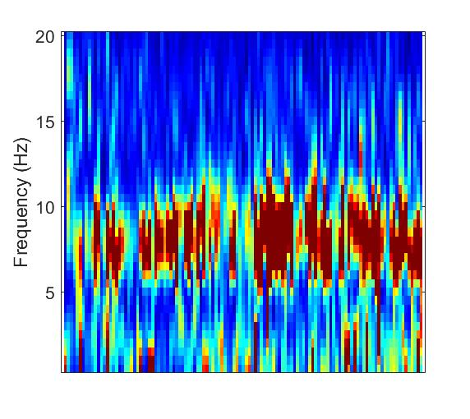
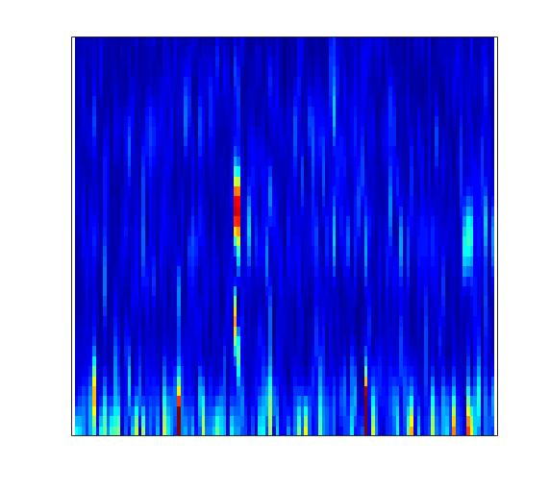
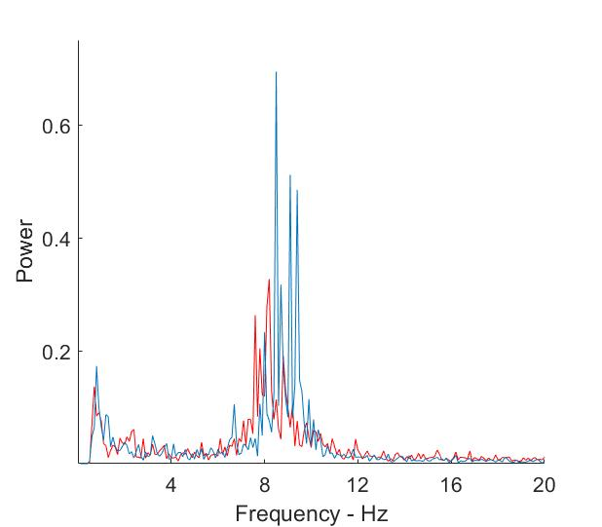
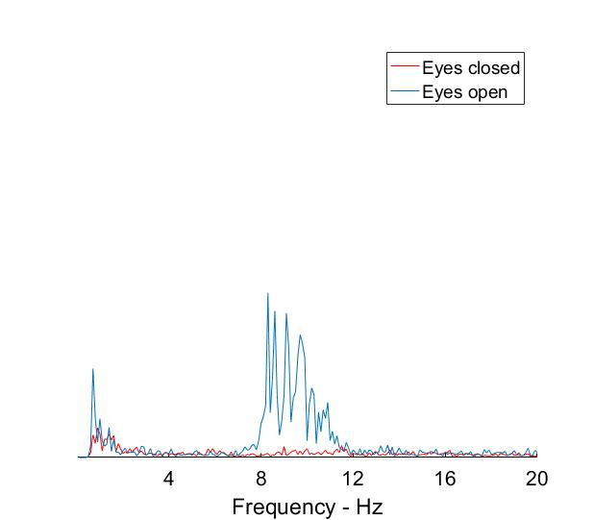

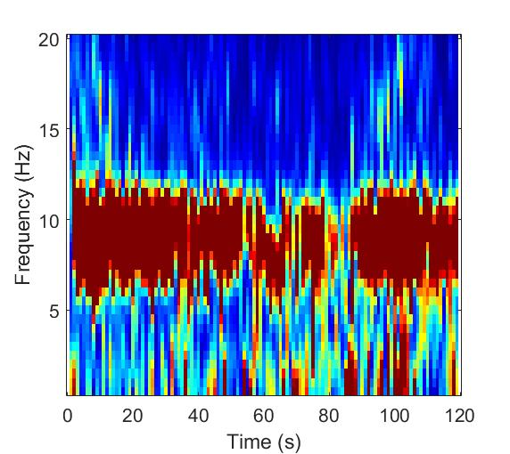
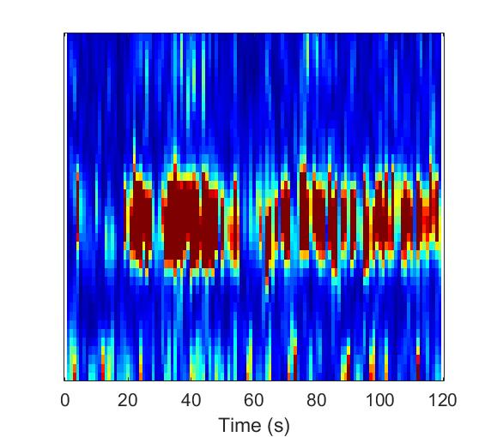
Sample Spectral data from single subject
Power
Frequency (Hz)
Frequency (Hz)
Time (seconds)

Slide 3
SNR study
MoCA
Test Box Measures
ANSI
DIR (SNR = 3)
DNR (AC 70 dB)
ANL (Unaided)
HINT/PPT (Unaided)
Real Ear Measures
MLST & Listening Effort Estimates
APHAB
HHIE/HHIA
DOSO SADL IOI-HA
SSQ12
CPIB
ALDQ
LESQ
NEO-FFI
Reading Span
Word Span

Slide 4
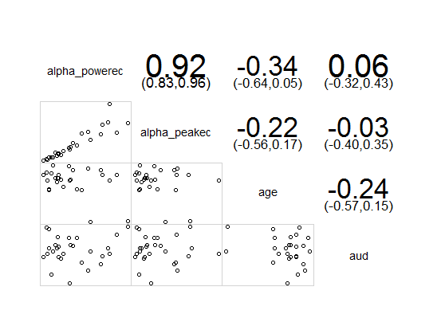
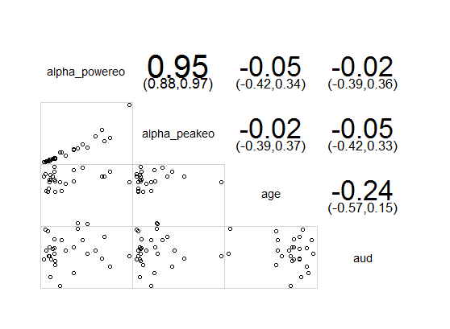
Alphapower vs age and audibility
Eyes Closed
Eyes Open

Slide 5
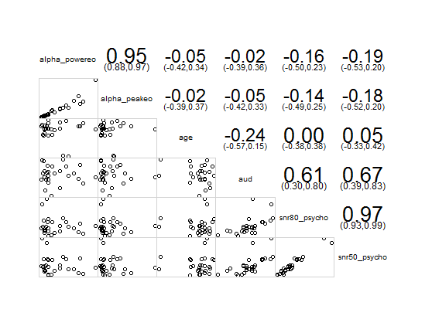

Alpha power vs SNR 50 and SNR 80

Slide 6
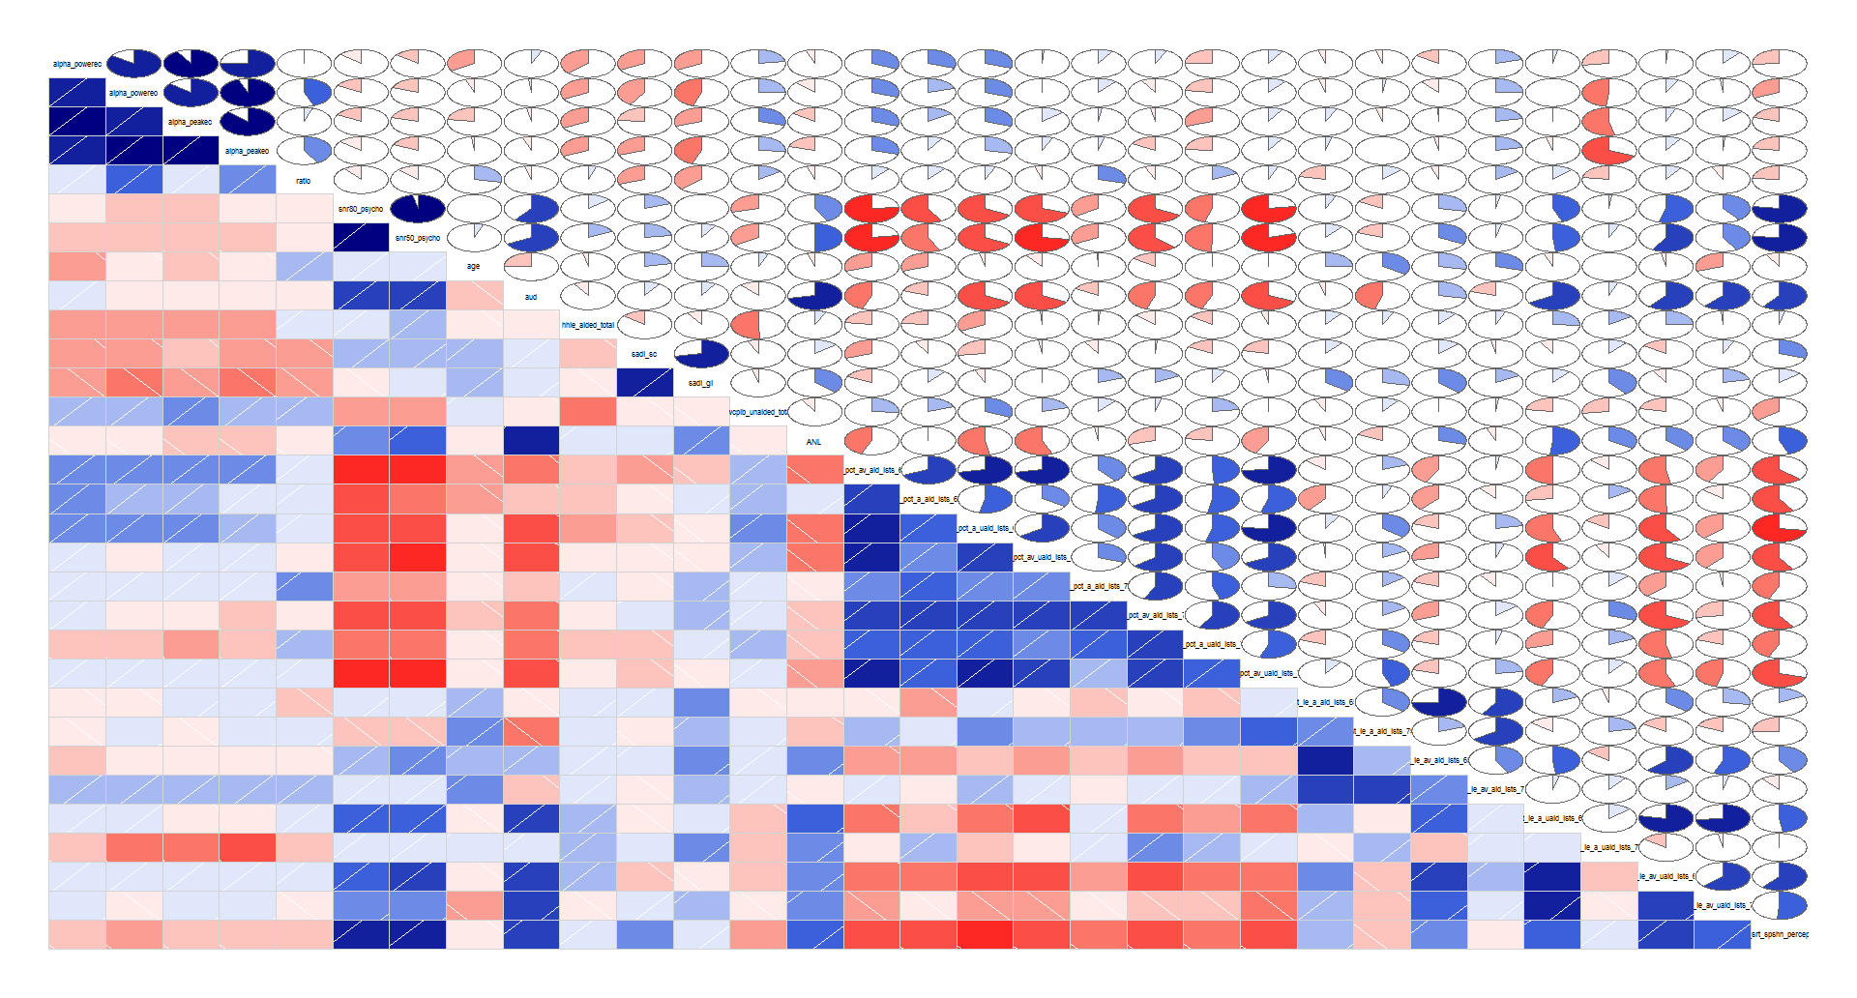

Slide 7
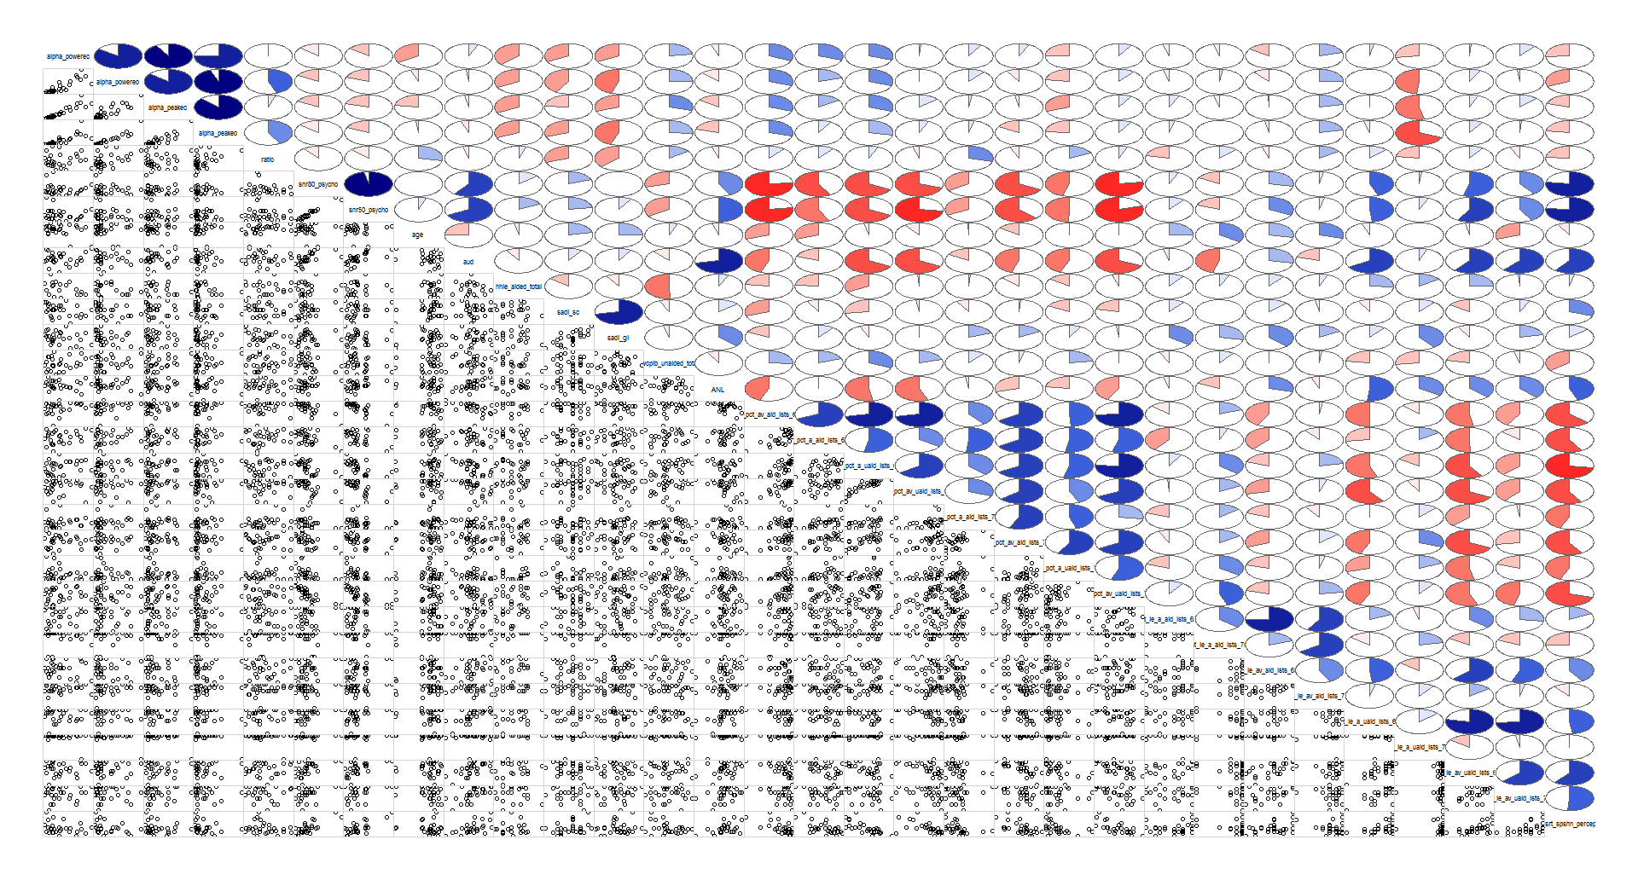

Slide 8
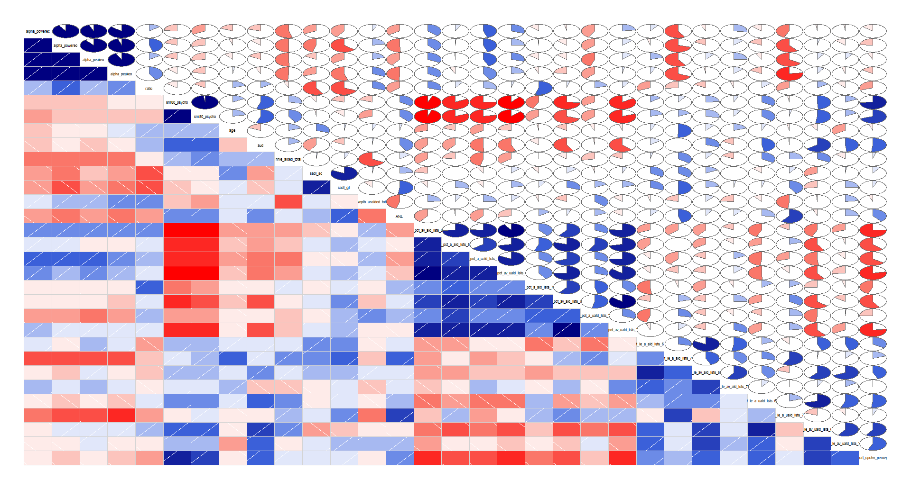
Audiobility between 25 and 40 db HL

Slide 9
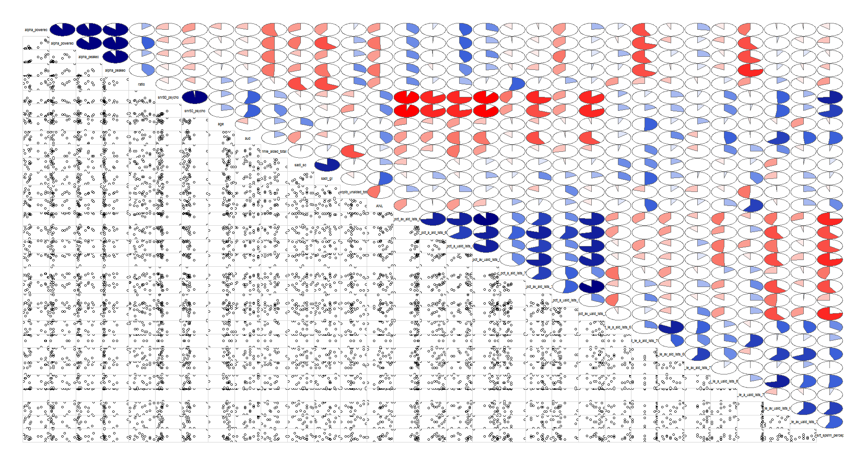
Audiobility between 25 and 40 db HL

Slide 10
Questions:
Measure alpha in ERP data?

